Slide 1
Capstone project 1 Hotel Booking Analysis Data Science Learners Team Team Members: Ayush Goyal M Sameer Ahamed Nitesh Bhowmick

Slide 2
Content
Problem Statements
Data Summary
Exploratory Data Analysis
EDA For Hotel Booking Analysis
Charts
Correlation Matrix
Challenges
Conclusion

Slide 3
Problem Statement
Analysis Based on Yearly Bookings Of Hotel.
Analysis Based on Monthly Bookings Of Hotel.
Analysis Based on Country of Guests Visiting Hotel.
Analysis Based on Bookings By Market Segment.
Analysis Based on Hotel Prices.
Analysis Based on Length Of In The Hotel.

Slide 4
Data summary
In the Hotel booking analysis project there is a Dataset which contains Booking information for city and resort hotels.
The dataset has total of 32 columns and 119390 rows.
The Dataset spans over 3 years that is 2015, 2016 & 2017.
The Dataset contains information on Length of stays, Numbers of guests, Bookings of hotel among other things.

Slide 5
Exploratory Data Analysis
Exploratory Data Analysis is also known as EDA, is the process of interpreting datasets by summarizing their key properties and frequently visualizing them.
EDA refers to the critical process of performing initial investigation on dataset so as discover the patterns, to spot anomalies, to test hypothesis, and to check assumptions with the help of summary statistics and graphical representation.
In EDA, plotting options include Box plots, Line plots, Scatter plots and many more.
EDA always comes first when conducting a data analysis.

Slide 6
EDA For Hotel Booking Analysis
In order to identify the length of stay, prices of hotel, bookings made and comparing of hotel types, we conducted Exploratory Data Analysis on the Hotel Booking Dataset.
EDA, means analysing the provided dataset and to look for patterns and assumptions.
There are attributes in the dataset, including years, months, days, countries, guests and many more.

Slide 7
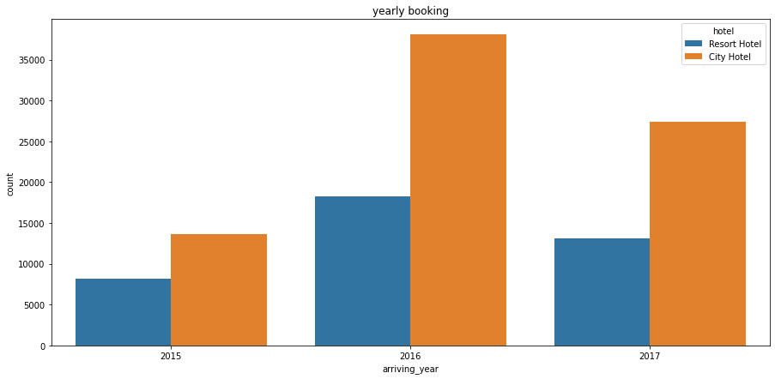
Hotel Wise Yearly Booking
The above graphs shows the Booking across years is higher for city hotel than resort hotel and most booking are in 2016 compared to 2015 and 2017.

Slide 8
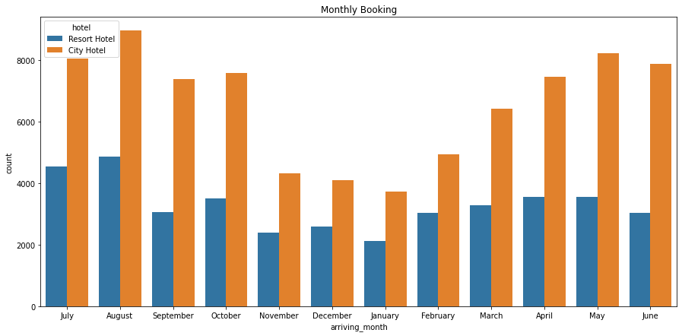
Hotel Wise Monthly Booking
The above graph shows the Bookings increases in monsoon and summer seasons.

Slide 9
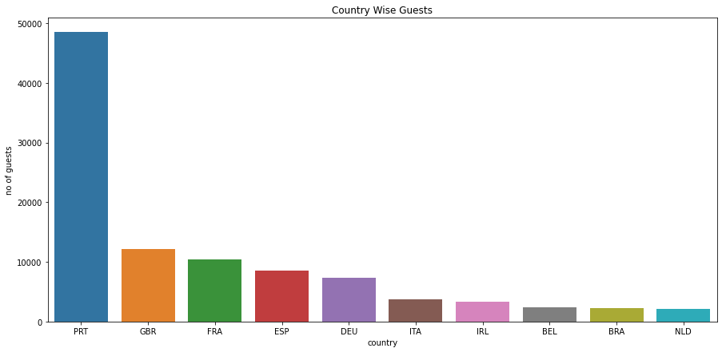
Country Wise Guests
The above Bar chart shows most of the guests from Portugal and other European Countries

Slide 10
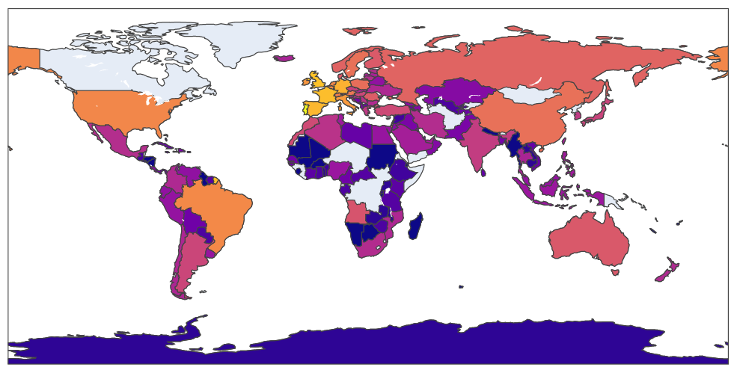


Slide 11
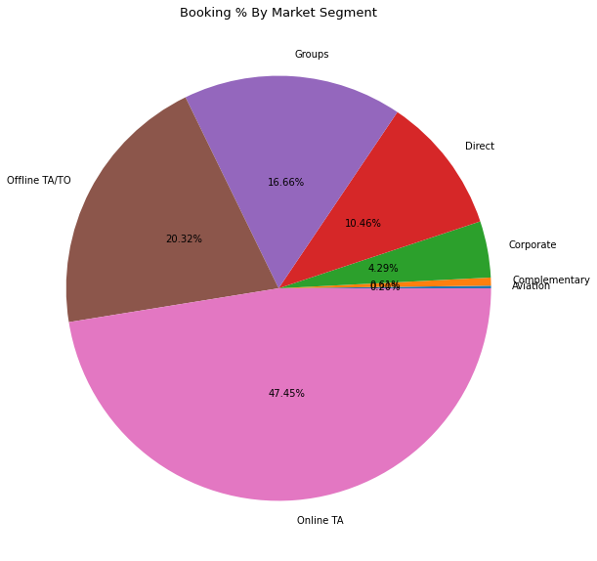
Bookings By Market Segnent
The above Pie chart shows the Most of the booking are done by online TA Market Segment.

Slide 12
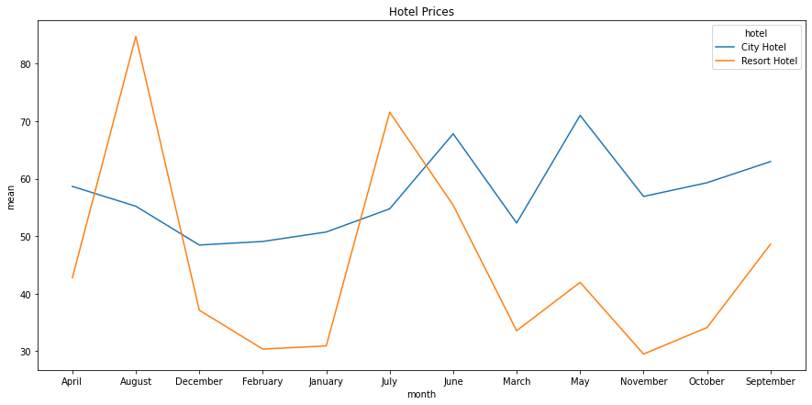
Month Wise Hotel Prices
The above line graph shows the price variations with the month, Here we observe resort hotel price
is much higher in summer than city hotel varies less and much expensive in spring and autumn.

Slide 13
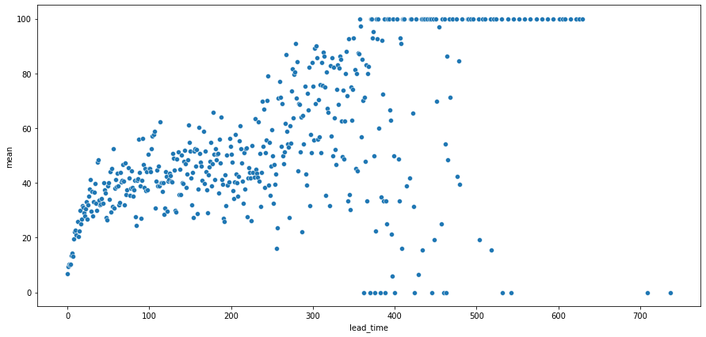
Relationship Between Leadtime and Cancellation
The above scatter plot shows that Leadtime has positive relation with Cancellation so increase in lead time the risk of cancellation increases.

Slide 14
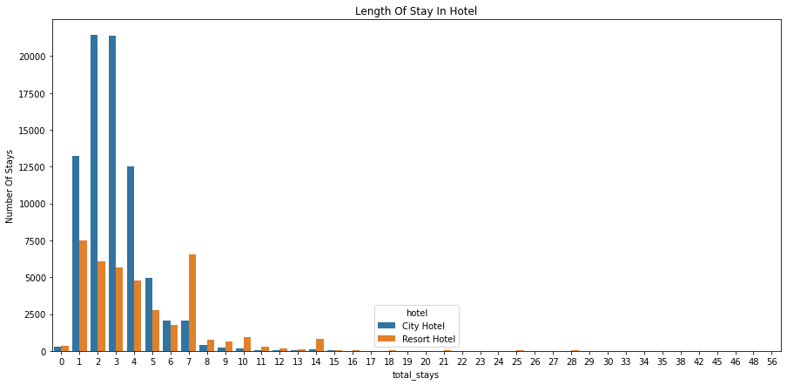
Total Length Of Stay
Most of the guests prefer to stay maximum of 3 nights and some of guests prefer to stay 5 nights
nights also.

Slide 15
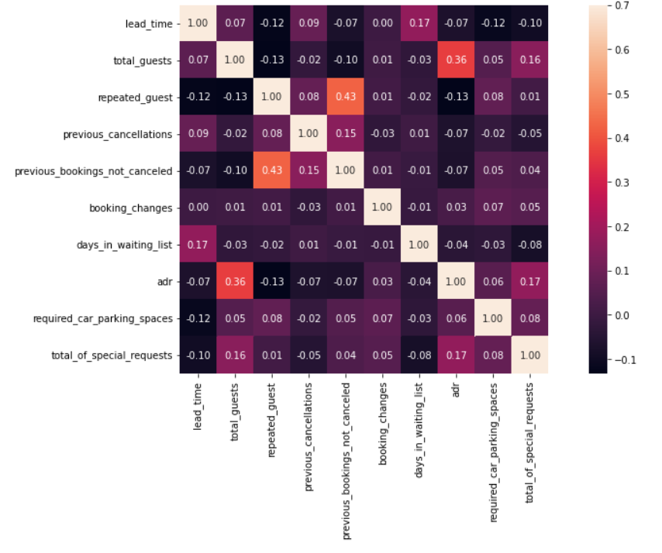
Correlation Between The Numerical Data
Total guests are slightly correlated with adr, which means as no of guests increases the revenue also
Increases and repeated guests are correlated with previous booking not canceled

Slide 16
Challenges
Understanding the columns of the dataset
There were many missing values in the dataset and removing the missing value columns.
Adding up the guests and stay columns which required for analysis
Finding the right graph for analysis of the dataset

Slide 17
CONCLUSION
1. The majority of the booking of the reservation are from city hotel than resort hotel.
2. The majority of the reservation are from monsoon season and summer season.
3. The most of the hotel booking from online TA market segment and offline TA/TO
market segment.
4. Most of the guest prefers to stay less than 5 nights in hotel.
5. The resorts hotels prices are much higher in summer season, City hotel prices varies
less and much expensive in Monsoon and Autumn seasons.
6. Possibility of cancellation of booking increases with increase in lead time.
7. Most of the guests visiting from Portugal and Other European Countries

Slide 18
Q&A

